Slide 1

JAVASCRIPT CHAPTER 3: JAVASCRIPT MULTIPLE VALUES

Slide 2
INTRODUCTION
The basic data types have been dealt with in the previous chapter. Now it's time to look at a slightly more complicated topic: arrays and objects. In the previous chapter, you saw variables that held just a single value. To allow for more complex programming, objects and arrays can contain multiple values. You can look at objects as a collection of properties and methods. Properties can be thought of as variables. They can be simple data structures such as numbers and strings, but also other objects. Methods perform actions; they contain a certain number of lines of code that will be executed when the method gets called. We’ll explain methods in more detail later in this book and focus on properties for now.

Slide 3
INTRODUCTION
An example of an object can be a real-life object, for example, a dog. It has properties, such as name, weight, color, and breed. We will also discuss arrays. An array is a type of object, which allows you to store multiple values. They are a bit like lists. So, you could have an array of items to buy at the grocery store, which might contain the following values: apples, eggs, and bread. This list would take the form of a single variable, holding multiple values.
Along the way, we will cover the following topics:
Arrays and their properties
Array methods
Multidimensional arrays
Objects in JavaScript
Working with objects and arrays

Slide 4
ARRAYS AND THEIR PROPERTIES
Arrays are lists of values. These values can be of all data types and one array can
even contain different data types. It is often very useful to store multiple values
inside one variable; for example, a list of students, groceries, or test scores. Once
you start writing scripts, you'll find yourself needing to write arrays very often; for
example, when you want to keep track of all the user input, or when you want to
have a list of options to present to the user.

Slide 5

CREATING ARRAYS
You might be convinced by now that arrays are great, so let's see how we can make them. There is actually a right way and a wrong way to do it. Here are both. Which one do you think is the right one?
If you guessed the second option, using square brackets, you are right. This is the best and most readable way to create a new array. On the other hand, the first option can do unexpected things. Look at both lines of code here. What do you think they will do?

Slide 6

CREATING ARRAYS
Probably, you sense that something is up here. They do not both create an array with one value, 10. The second one, arr4, does. The first option creates an array with 10 undefined values. If we log the values like this:
Here is what it logs:
Thanks, JavaScript! That was very helpful. So, unless that is what you need to do, please use the square brackets!

Slide 7
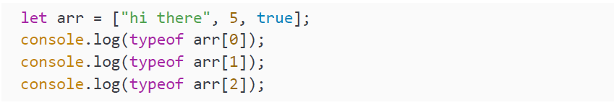
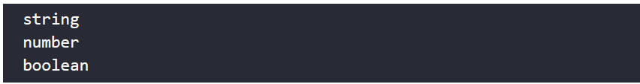
CREATING ARRAYS
As I already mentioned, we can have mixed arrays and arrays can hold any type of variable. The values of the array won't be converted to a single data type or anything like that. JavaScript simply stores all the variables with their own data type and value in the array:
This will output to the console:

Slide 8
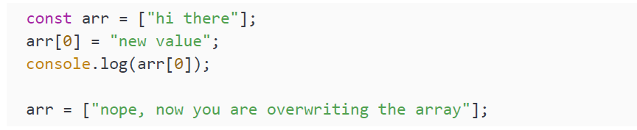
CREATING ARRAYS
The last array fun fact we will go over here is what happens if you define an array using const. You can change the values of a constant array, but you cannot change the array itself. Here is a piece of code to demonstrate:
The new value for the first element of the array is going fine, but you cannot assign a new value to the full array. Here is what it will output:

Slide 9
ACCESSING ELEMENTS
This beautiful array we just made would become much more powerful if we could access its elements. We can do this by referencing the array's index. This is something we did not specify when we created the array, and we did not need to either. JavaScript assigns an index to every value of the array. The first value is assigned the position of 0, the second 1, the third 2, and so on. If we want to call a specific value based on its position in the array, we can use the name of our array, add square brackets to the end, and put the index we want to access between the square brackets, like this:
This log statement will write Toyota to the console because we called for the position 0 of the array, which outputs the first value in the list.

Slide 10
ACCESSING ELEMENTS
Calling index position 1 is giving us the second element in the array, which is Renault. This will be logged to the console.
The third element in our array has index 2, so this one will log Volkswagen. What do you think will happen if we use a negative index or an index that is higher than the number of values we get?
We didn't assign a value to the negative or non-existent index, so when we ask for it, the value is undefined. As such, the log output will be undefined. JavaScript does not throw an error because of this.

Slide 11
OVERWRITING ELEMENTS
The elements in an array can be overwritten. This can be done by accessing a certain element using the index and assigning a new value:
The output of this log is Tesla because it has overwritten the old value, Toyota. If we output the whole array:
It will output the following:

Slide 12
OVERWRITING ELEMENTS
What happens if you try to overwrite an element that does not exist?
Or even a negative index?
Let's see what happens when we try to write the values to the console:
And the output:
Ha! They suddenly exist. How is that you may wonder? We will discuss this in the next section. For now, just remember that this is not the right way to add values to the array. We will discuss the right way when we explain arrays in the Array methods section.

Slide 13
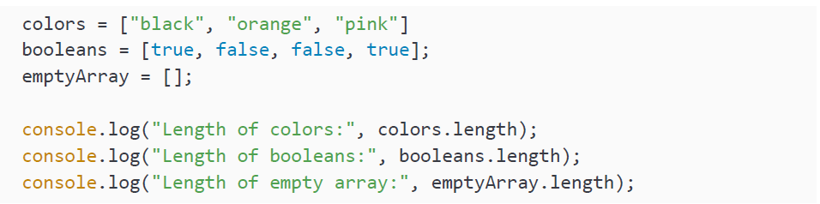
BUILT-IN LENGTH PROPERTY
Arrays have a very useful built-in property: length. This will return the number of values that the array has:

Slide 14
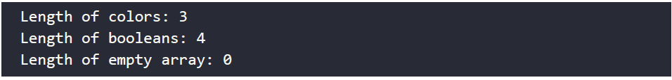
BUILT-IN LENGTH PROPERTY
The first console.log call returns 3, indicating that the colors array contains 3 values. The second one returns 4, and the last one is an empty array with a length of 0:
So, be aware that the length is one higher than the maximum index because the index of the array starts at 0, but when determining the length, we look at the number of elements and there are four separate elements. This is why the maximum index is 3 when the length is 4. Hence, the positional value of the last element in the array will be one fewer than the total number of elements.

Slide 15

BUILT-IN LENGTH PROPERTY
Take a moment and try to figure out how you can use the length to access the last element of the array:
You get the highest index by subtracting 1 from the length because, as you know, arrays are zero-indexed. So, the positional value of the last element in the array will be one fewer than the total number of elements.
So, this might seem pretty straightforward. Remember the non-existent index position we called in the previous section? Let's see what happens in this example:

Slide 16
BUILT-IN LENGTH PROPERTY
The length of the array is only counting the integer numbers starting from 0 up to the highest filled index. If there are elements in the middle of the sequence that do not have a value, they will still get counted. In this case, the length becomes 6. If we log the array, we can see why:
The output will be as follows:
Because we added an element, 48, at index 5, it also created 2 elements at index positions 3 and 4 containing empty values. For now, let's have a look at array methods and find out the right way to add to an array.

Slide 17
PRACTICE EXERCISE 3.1
Create an array to use as your shopping list with 3 items: "Milk," "Bread," and "Apples."
Check your list length in the console.
Update "Bread" to "Bananas."
Output your entire list to the console.

Slide 18
ARRAY METHODS
We have just seen the built-in length property. We also have a few built-in methods.
Methods are functions on a certain object. Instead of holding a value, like properties,
they perform actions. We will cover functions in-depth in Chapter 6, Functions. For
now, all you need to know is that you can call methods and functions, and when
you do, some code that is specified inside that function gets executed.
We just accidentally saw we could add elements using new indices. This is not
the proper way to do it as it is easy to make mistakes and accidentally overwrite
a certain value or skip a certain index. The right way is to do this with a special
method. Similarly, we can also delete elements and sort the elements in the array.

Slide 19
ADDING AND REPLACING ELEMENTS
We can add elements with the push() method:
The value gets added to the end of the array. The push method returns the new length of the array, four in this case. You can store this length in a variable like this:
The value 5 gets stored in the lengthOfFavoriteFruits variable. If we log our array, favoriteFruits, like this:
Here is the new array:

Slide 20
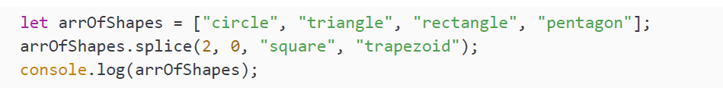
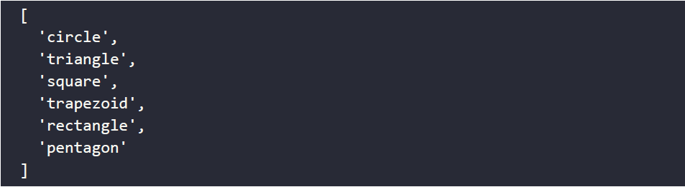
ADDING AND REPLACING ELEMENTS
This was easy right? But what if you would want to add elements at a certain index? You can use the splice() method. This one is slightly more difficult:
After this, the output containing the array is as follows:

Slide 21
ADDING AND REPLACING ELEMENTS
First, let's point out the different layouts of this output. This might depend on the interpreter you are using, but at some point, it will decide it is too long for a single line and apply an automatic format to the array to make it more readable. It doesn’t change the value of the array; it is just a different representation of the same values were they to be on a single line.
As you can see, the square and trapezoid get inserted on index 2. The rest of the array is shifting to the right. The splice() method takes multiple parameters. The first parameter, 2 in our case, is the index of the array on which we want to start inserting. The second parameter, 0 in our case, is the number of elements we want to delete starting at our previously defined starting index. The parameters after these first two, square and trapezoid in our case, are whatever should be inserted starting at the start index.

Slide 22
ADDING AND REPLACING ELEMENTS
So, had we said this instead:
It would have replaced the elements rectangle and pentagon and added square and trapezoid in their place, as follows:

Slide 23
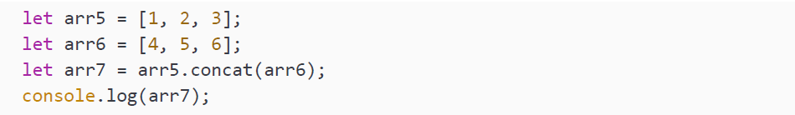
ADDING AND REPLACING ELEMENTS
You can also add another array to your array. This can be done with the concat() method. This way, you can create a new array that consists of a concatenation of both arrays. The elements of the first array will be first, and the elements of the argument of concat() will be concatenated to the end:
And here is the output:

Slide 24
ADDING AND REPLACING ELEMENTS
This concat() method can do even more! We can use it to add values as well. We can add a single value, or we can comma-separate multiple values:
The new value of the array will be as follows:

Slide 25
DELETING ELEMENTS
There are several ways in which you can delete elements from an array. Removing the last element is done with pop():
Logging the array after executing pop() results in this:
Deleting the first element can be done with shift(). This causes all other indices to be reduced by one:
The new array will be:

Slide 26
DELETING ELEMENTS
Remember splice()? This is a very special method because we can also use it to delete values. We specify the index from where we want to start deleting, and then the number of elements we want to delete.
After this, the value of the array is as follows:

Slide 27
DELETING ELEMENTS
As you can see, 3 elements starting from the second positional index have been deleted. The values 3, 4, and 5 are gone. If you do not wish to change any of the later indices, you can also use the operator delete. This is not a method, but you can use it to change the value of a certain position of the array to undefined:
The array then becomes:
This is useful when you are relying on index or length for some reason. For example, if you are keeping user input, and you want to determine the number of user inputs based on an array that the user is pushing to, deleting would decrease the number of inputs, whereas that might not be what you would want.

Slide 28
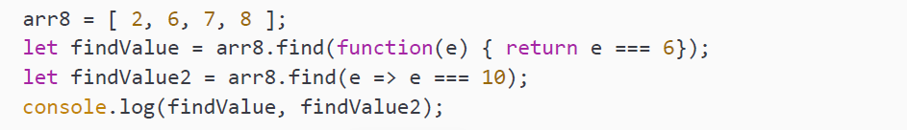
FINDING ELEMENTS
If you want to check whether a value is present in an array, you can use the find() method. What will go in the find() method is somewhat different. It is actually a function. This function will be executed on every element in the array until it finds a match, and if it does not, then it will return undefined.
Do not worry if this is too difficult for now; it will become clear soon enough. We are writing the function in two different ways in the following code snippet. They are actually doing the same, except that the first one is checking for an element being equal to 6, and the second for an element being equal to 10:
The log statement will log 6 and undefined because it can find an element that matches for 6, but not one that matches for 10.

Slide 29
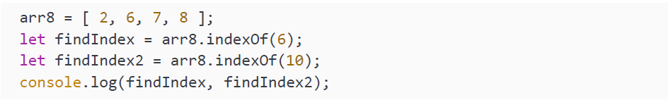
FINDING ELEMENTS
A function can take a certain input. In this case, it takes the element of the array as an input. When the element of the array equals 6 (findValue) or 10 (findValue2), it returns the element. In Chapter 6, Functions, we will cover functions in much more detail. It is a lot for a beginner to take in, so you can review this a bit later if it is unclear for now.
Often, you do not only want to find the element, but you want to know what position it is on. This can be done with the indexOf() method. This method returns the index on which the value is found. If a value occurs in an array more than once, it will return the first occurrence. If the value is not found, it will return -1:
So, the first one will return 1 since that is the index position of 6 in the array. The second one will return -1 because the array does not contain 10.

Slide 30
FINDING ELEMENTS
If you want to find the next occurrence of the specified number, you can add a second argument to indexOf(), specifying from which position it should start searching:
In this case, the value of findIndex3 will be -1, because 6 cannot be found starting from index 2.
The last occurrence can also be found. This is done with the lastIndexOf() method:
The value of lastDog will be 4 because that is the last occurrence of dog in the array.

Slide 31
SORTING
There is also a built-in method for sorting arrays. It sorts numbers from small to high and strings A-Z. You can call sort() on an array and the order of the values of the array will change to a sorted order:
The value of names after sorting is as follows:
As you can see, the array is now sorted alphabetically. For numbers, it is sorting them in ascending order, as you can see in the following code snippet:
After executing this sort() method, the value of ages is:

Slide 32
REVERSING
The elements of the array can be reversed by calling the built-in method, reverse(), on an array. It puts the last element first, and the first element last. It does not matter whether the array is sorted or not; it just reverses the order.
The value of names before reversing is as follows:
Now we are going to call the reverse() method:
The new order will be:

Slide 33
PRACTICE EXERCISE 3.2
Create an empty array to use as a shopping list.
Add Milk, Bread, and Apples to your list.
Update "Bread" with Bananas and Eggs.
Remove the last item from the array and output it into the console.
Sort the list alphabetically.
Find and output the index value of Milk.
After Bananas, add Carrots and Lettuce.
Create a new list containing Juice and Pop.
Combine both lists, adding the new list twice to the end of the first list.
Get the last index value of Pop and output it to the console.
Your final list should look like this:

Slide 34
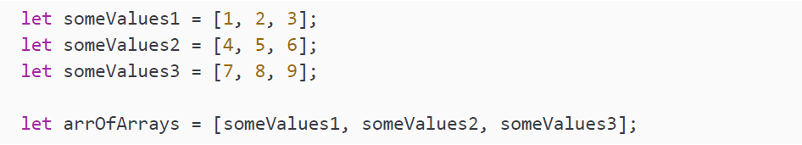
MULTIDIMENSIONAL ARRAYS
Earlier, we established already that arrays can contain any data type. This means that arrays can also contain other arrays (which, in turn, can contain… other arrays!). This is called a multidimensional array. It sounds complicated, but it is just an array of arrays: a list of lists:
So, we can create an array of already existing arrays. This is called a two-dimensional array. We can write it like this:

Slide 35
MULTIDIMENSIONAL ARRAYS
If you want to access elements of the inner arrays, you will have to specify an index twice:
The statement will grab the first array because it has an index position of 0. From this first array, it will take the second value, because it has an index position of 1. Then it stores this value in value1. That means the value of value1 will be 2. Can you figure out what the value of the next one will be?
It takes the third array, and from this third array, it takes the third value. Thus, 9 will be stored in value2. And it does not stop here; it can go many levels deep. Let's show that by creating an array of our array of arrays. We are simply going to store this array three times in another array:

Slide 36
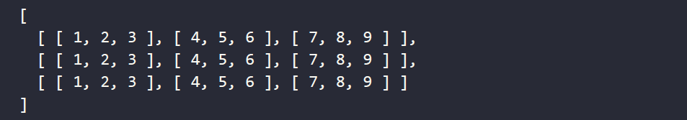
MULTIDIMENSIONAL ARRAYS
This is what the array looks like in terms of values:
Let's get the middle element of this array, which is the value 5, belonging to the second array of arrays. It is done like this:
The first step is to get the second array of arrays, so index 1. Then we need to get the second array of this one, which again is index 1. Now we reach the level of the values, and we need the second value, so again we use index 1. This is useful in many situations, for example, when you want to work with matrices.

Slide 37
PRACTICE EXERCISE 3.3
Create an array containing three values: 1, 2, and 3.
Nest the original array into a new array three times.
Output the value 2 from one of the arrays into the console.

Slide 38
OBJECTS IN JAVASCRIPT
Now it is time to have a look at another complex data structure that can contain more than one value: objects! Objects are very useful and can be used to describe real-life objects as well as more complex abstract concepts that allow for more flexibility in your code.
Secretly, you have just been introduced to objects already, because arrays are a very special type of object. Arrays are objects with indexed properties. All the other objects, and also the objects we will see here, are objects with named properties. This means that instead of an automatically generated index number, we will give it a custom descriptive name.
As we can tell from the following code, arrays are defined by JavaScript as being of the object type:
The output of the preceding code is as follows:

Slide 39
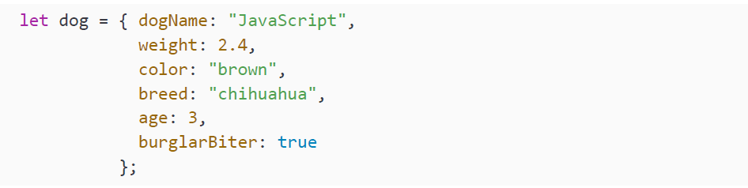
OBJECTS IN JAVASCRIPT
Objects are not too dissimilar to real-world objects. They have properties and they can perform actions, methods. Here, we will only deal with the properties. We will cover methods in Chapter 7, Classes, after we have seen functions. An object is a chance to group multiple variables into one. This is done with curly brackets: { and }. Let’s have a look at this object of a dog here:
We created a variable, dog, and we gave this an object as a value. We can recognize that this is an object by seeing the { and }. In between the curly braces, we see a bunch of properties and their values.

Slide 40
OBJECTS IN JAVASCRIPT
If you have ever wondered whether something should be a property, just try the following template sentence in your head:
For example, a dog has a name, a dog has a color, and a dog has a weight. This is slightly different for the Boolean properties, for which you can use "is" or "is not“ instead of "has".
We can access the properties of this object in a very similar way as we would with the array. This time, we are not using the index number, but the name of the property, to get the value:
There is another way to do this. Instead of the square brackets, the property name can also be added to the object name with a dot in between:
This might look familiar. Do you remember how we got the length of an array with the built-in property length? Yes—the same way! The difference between properties and methods is the lack of parentheses for properties.

Slide 41
UPDATING OBJECTS
We can change the value of the properties of the objects. Again, this is similar to an array because an array is an object as well, but for properties, we have two options:
This has changed the properties of our chihuahua JavaScript. The color gets updated to blue and it has lost a little bit of weight since the new weight is 0.1 lower. So if we log our dog:

Slide 42
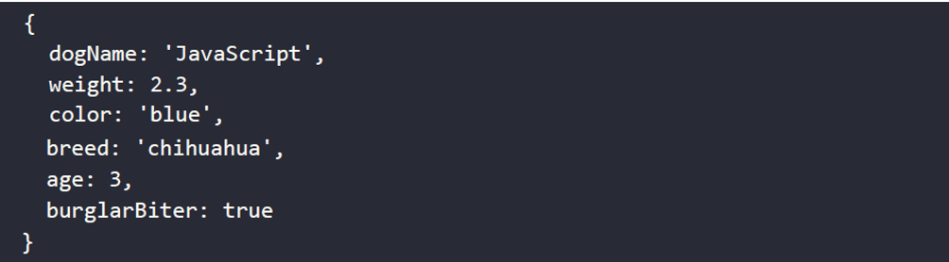
UPDATING OBJECTS
We will get the following:

Slide 43
UPDATING OBJECTS
It's useful to note that if we change the data type of one of our properties, for example:
This is not a problem. JavaScript will just change the whole value and data type to the new situation.
Another element to note is that we are now using the literal string values to refer to the object's properties, but we can also work with variables to achieve this. So, for example:

Slide 44
UPDATING OBJECTS
This will still output three, as we just changed the value of age to three. If we change the value of the variable to another dog property, we will be accessing another property, like this:
This will print chihuahua. And when we update the value accessing this way, it is the exact same as when we would have accessed it with the literal string:
So, this will log dachshund to the console.

Slide 45
PRACTICE EXERCISE 3.4
Create a new myCar object for a car. Add some properties, including, but not limited to, make and model, and values for a typical car or your car. Feel free to use booleans, strings, or numbers.
Create a variable that can hold the string value color. This variable containing a string value color can now be used to reference the property name within myCar. Then, use the variable within the square bracket notation to assign a new value to the color property in myCar.
Use that same variable and assign a new property string value to it, such as forSale. Use the bracket notation once again to assign a new value to the forSale property to indicate whether the car is available for purchase.
Output make and model into the console.
Output the value of forSale into the console

Slide 46
WORKING WITH OBJECTS AND ARRAYS
When working with objects and arrays, you will see these often combined. In the
last section of this chapter, we will deal with combining objects and arrays, and
also objects inside objects.

Slide 47
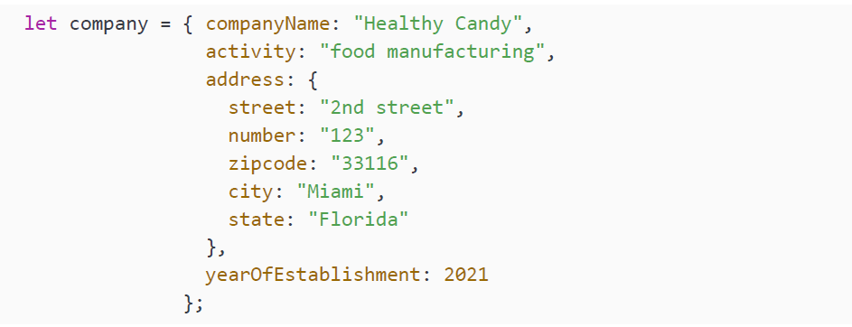
OBJECTS IN OBJECTS
Let's say we want to have an object for a company. This company will have an address. And an address is another object. If we give our company an address, we are using an object inside an object:
As you can see, our company object has an address object with values. This can go very many levels deep if necessary.

Slide 48
OBJECTS IN OBJECTS
To access or modify one of the properties of the address here, we can use two approaches:
As you can see, this is very similar to the array. We first need to select the address and then do the same thing to access the property we want to change.

Slide 49
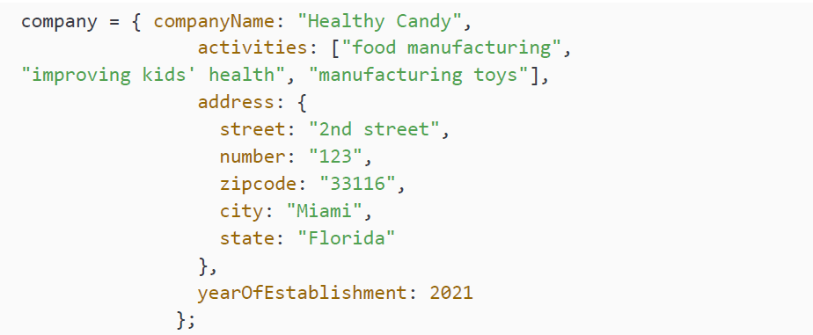
VIDEO STORE PRODUCT PAGE (REVISITED)
Our company might have a range of activities instead of one. We can simply replace the activity from our previous sample with an array:

Slide 50
VIDEO STORE PRODUCT PAGE (REVISITED)
We have now used an array in our company object. You can simply use an array with the square braces after the property. Retrieving the individual values is very similar. The second value of the activities array can be fetched using this statement:
Here, we call the object we're interested in, company, then the relevant array, activities, with reference to the index position of the variable we're looking for within the array, which is 1.

Slide 51
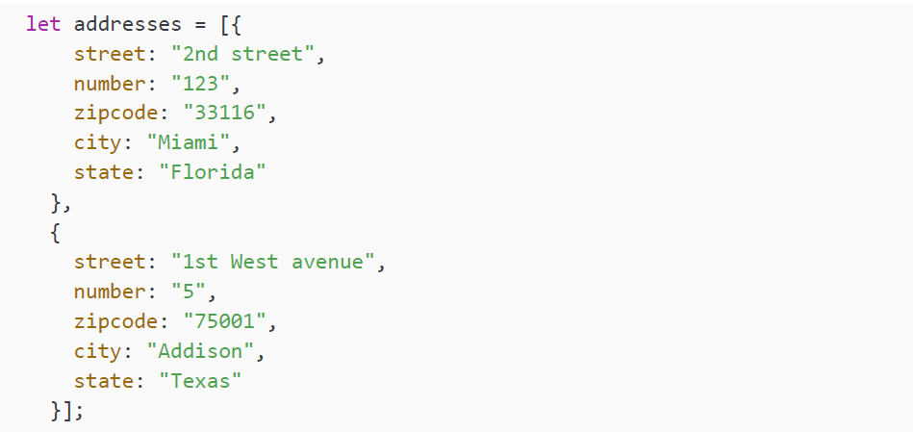
OBJECTS IN ARRAYS
It is very possible that instead of one address, our company has a list of addresses. We can accomplish this by creating an array of address objects. In this case, we will create an array of two:

Slide 52
OBJECTS IN ARRAYS
So, the arrays can be recognized by the square brackets and the objects by the curly brackets. The street name of the first object can be fetched using this statement:
Here, we call the array we're interested in, addresses, with reference to the index position of the object we're looking for within the array, 0, and then the required variable from within the object, which is street. This may seem complicated, but you may notice that this simply reverses the syntax required to retrieve a variable from an array inside an object from the previous section. It's worth practicing calling variables from nested arrays and objects until you're comfortable with it!

Slide 53
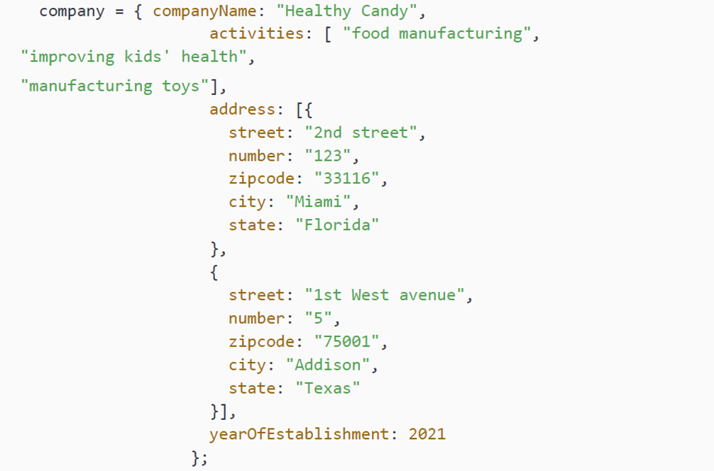
OBJECTS IN ARRAYS IN OBJECTS
Just to show that this can go as many levels as we would need, we are going to give our company object an array of address objects. So, let's add this array of address objects to our company object. This way, our company has an array of addresses:

Slide 54
OBJECTS IN ARRAYS IN OBJECTS
To access elements of increasingly nested objects and arrays, we simply extend the same logic you have seen in the previous sections. To access the street name of Healthy Candy's first address, we can use the following code:
As you see, we can stack object and array element requests indefinitely.
We will not make it any more complicated than this for now. Whenever you need a list of something, you will be using an array. Whenever you want to represent something with properties that have descriptive names, it is better to use an object. Just remember that object properties can be of any type.

Slide 55
PRACTICE EXERCISE 3.5
Create an object named people that contains an empty array that is called friends.
Create three variables, each containing an object, that contain one of your friend's first names, last names, and an ID value.
Add the three friends to the friend array.
Output it to the console.

Slide 56
MANIPULATING AN ARRAY
Take the following array:
Manipulate your array using various methods, such as pop(), push(), shift(), and unshift(), and transform it into the following:
You can take the following steps, or adopt your own approach:
• Remove the first item and the last item.
• Add FIRST to the start of the array.
• Assign hello World to the fourth item value.
• Assign MIDDLE to the third index value.
• Add LAST to the last position in the array.
• Output it to the console.

Slide 57
COMPANY PRODUCT CATALOG
In this project, you will implement a data structure for a product catalog and create queries to retrieve data.
Create an array to hold an inventory of store items.
Create three items, each having the properties of name, model, cost, and quantity.
Add all three objects to the main array using an array method, and then log the inventory array to the console.
Access the quantity element of your third item, and log it to the console. Experiment by adding and accessing more elements within your data structure.

Slide 58
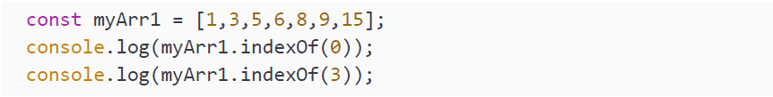
SELF-CHECK QUIZ
Can you use const and update values within an array?
Which property in an array gives the number of items contained in the array?
What is the output in the console?
How do you replace the second element in an array myArr = [1,3,5,6,8,9,15] with the value 4?

Slide 59
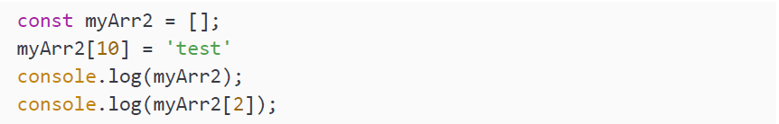
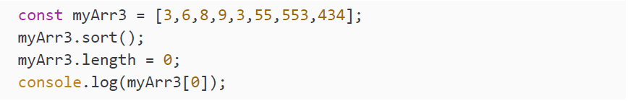
SELF-CHECK QUIZ
5. What is the output in the console?
6. What is the output in the console?

Slide 60
SUMMARY
So, in this chapter, we have seen arrays and objects. Arrays are a list of values. These could be values of the same type, but also values of different types. Every element of the array gets an index. The index of the first element is 0. We can access the elements of the array using this index. We can also use this index to change and delete the element.
We then saw that it is also possible to have arrays containing other arrays; these are multidimensional arrays. To access the elements of a multidimensional array, you would need to use as many indices as you have nested arrays.
Then, we covered objects and learned that arrays are a special kind of object. Objects contain properties and methods. We looked at the properties of objects and saw that these properties are given a name and can be accessed and modified using this name.
We ended this module by looking at how arrays can contain objects, and how objects can contain arrays and more. This enables us to create complex object structures, which will be of great use in designing real-life applications.

